Slide 1
Eclipse EE Installation Guide

Slide 2
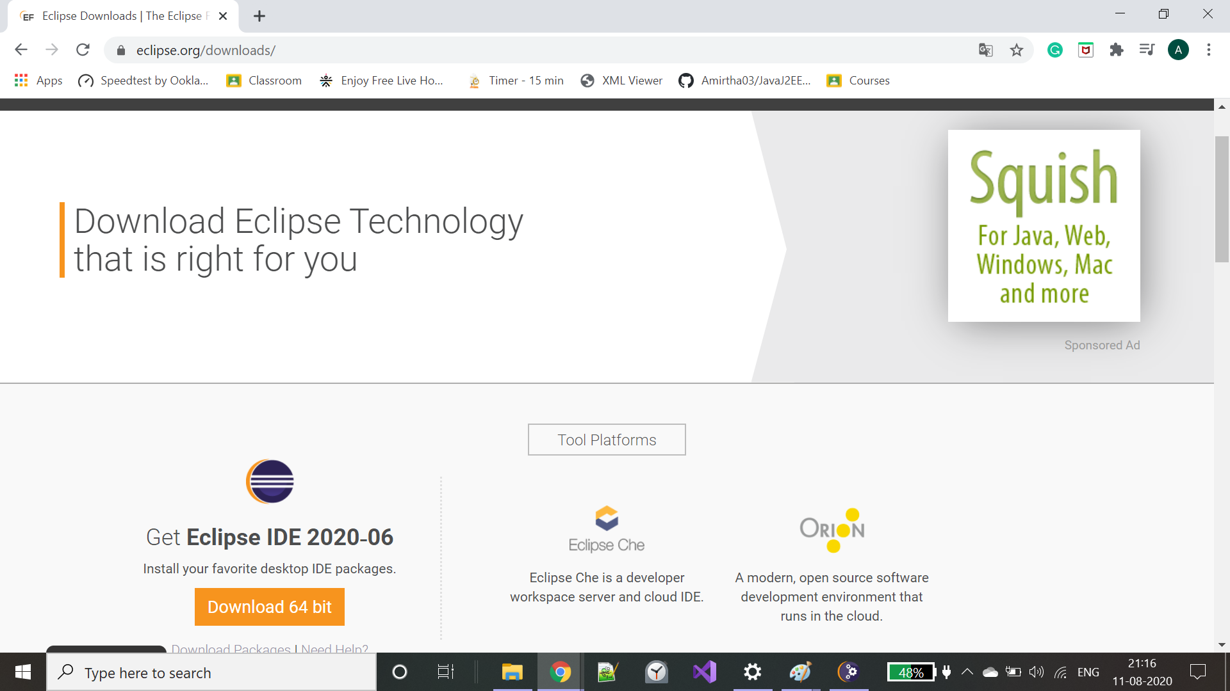
Goto eclipse.org and download the software

Slide 3
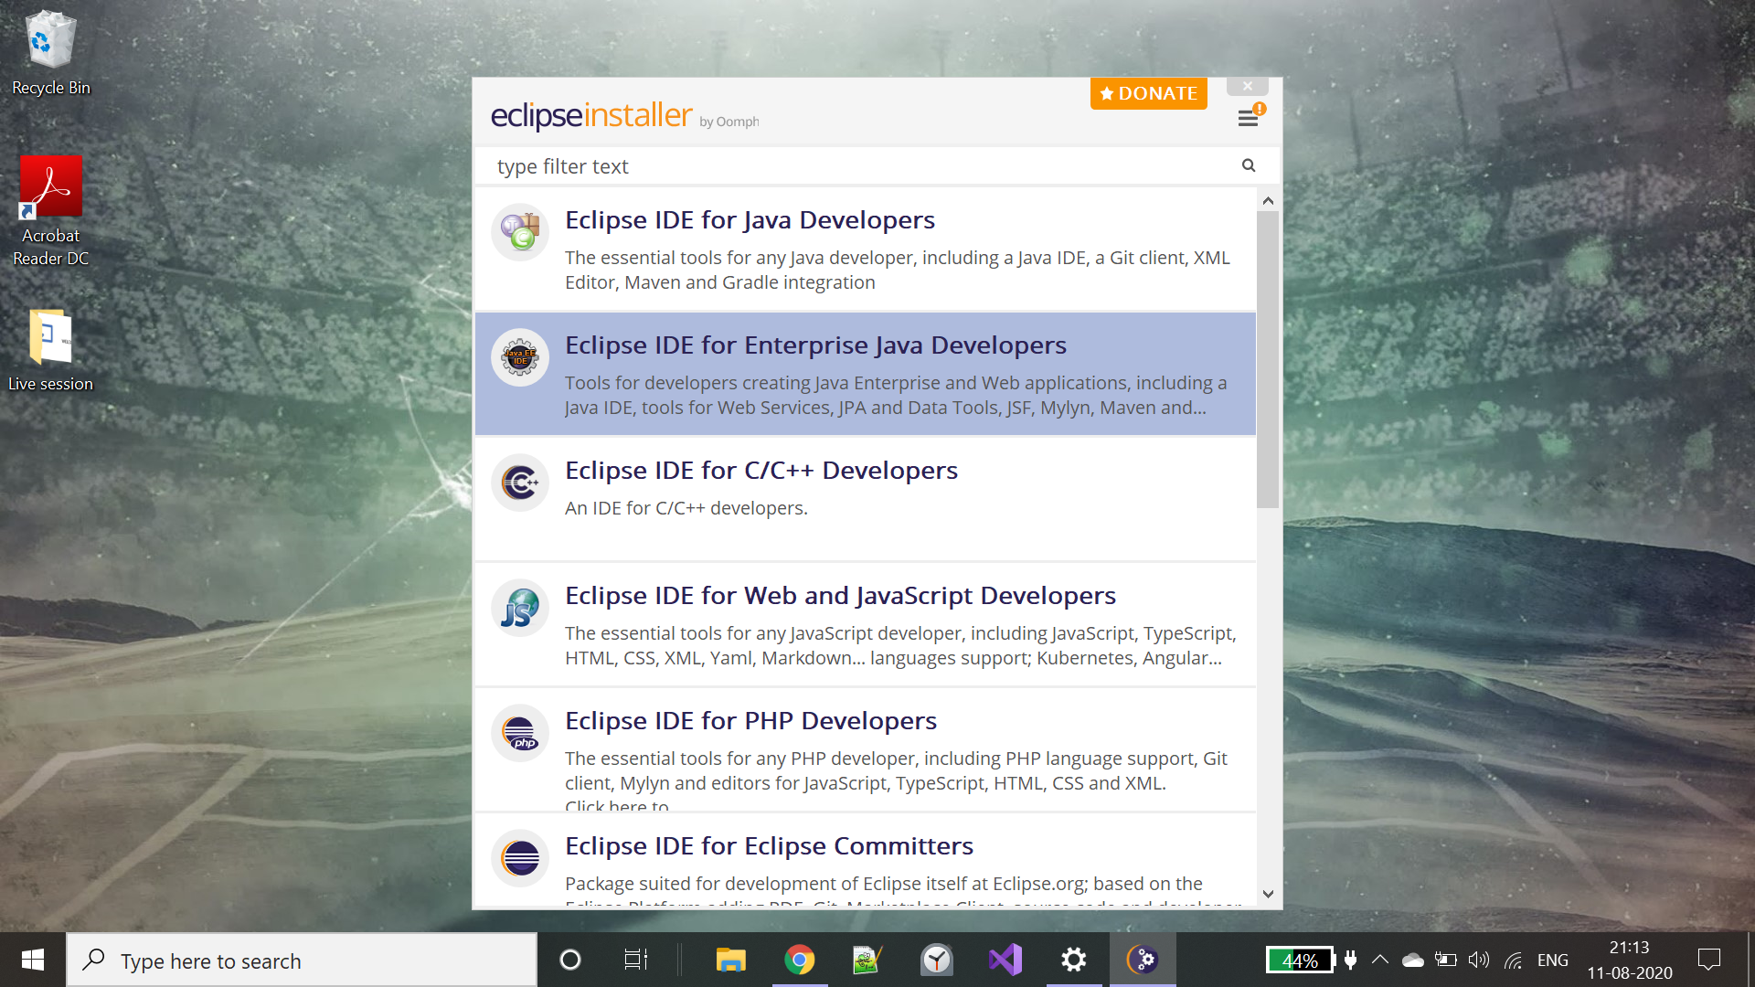
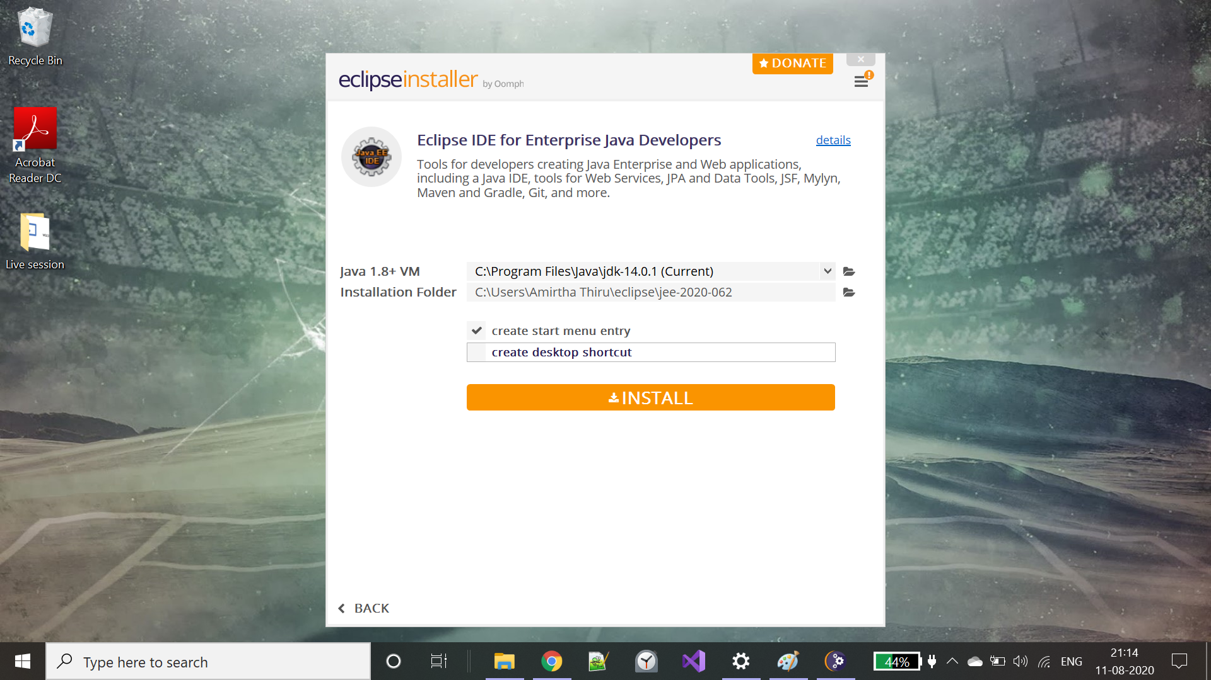
Choose Eclipse IDE for Enterprise Java Developers

Slide 4
Double click to run eclipse-inst-win64.exe from downloads folder

Slide 5
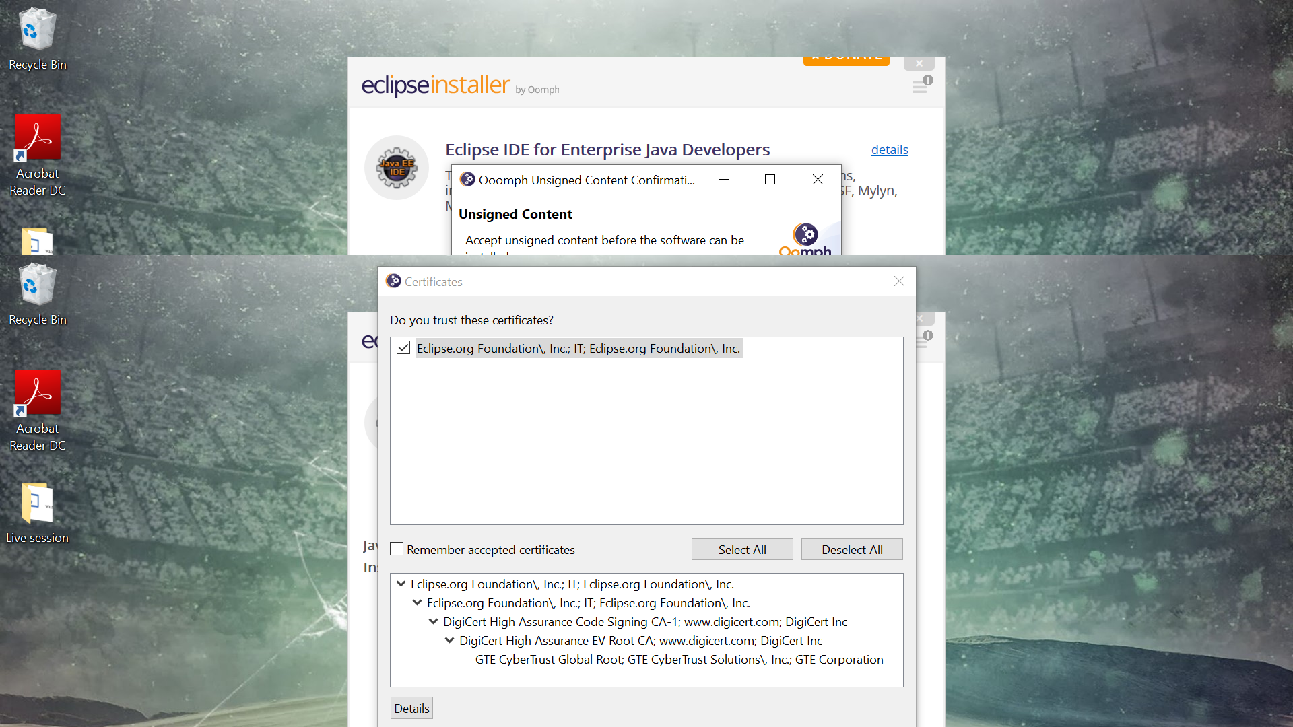
Accept the certificate

Slide 6
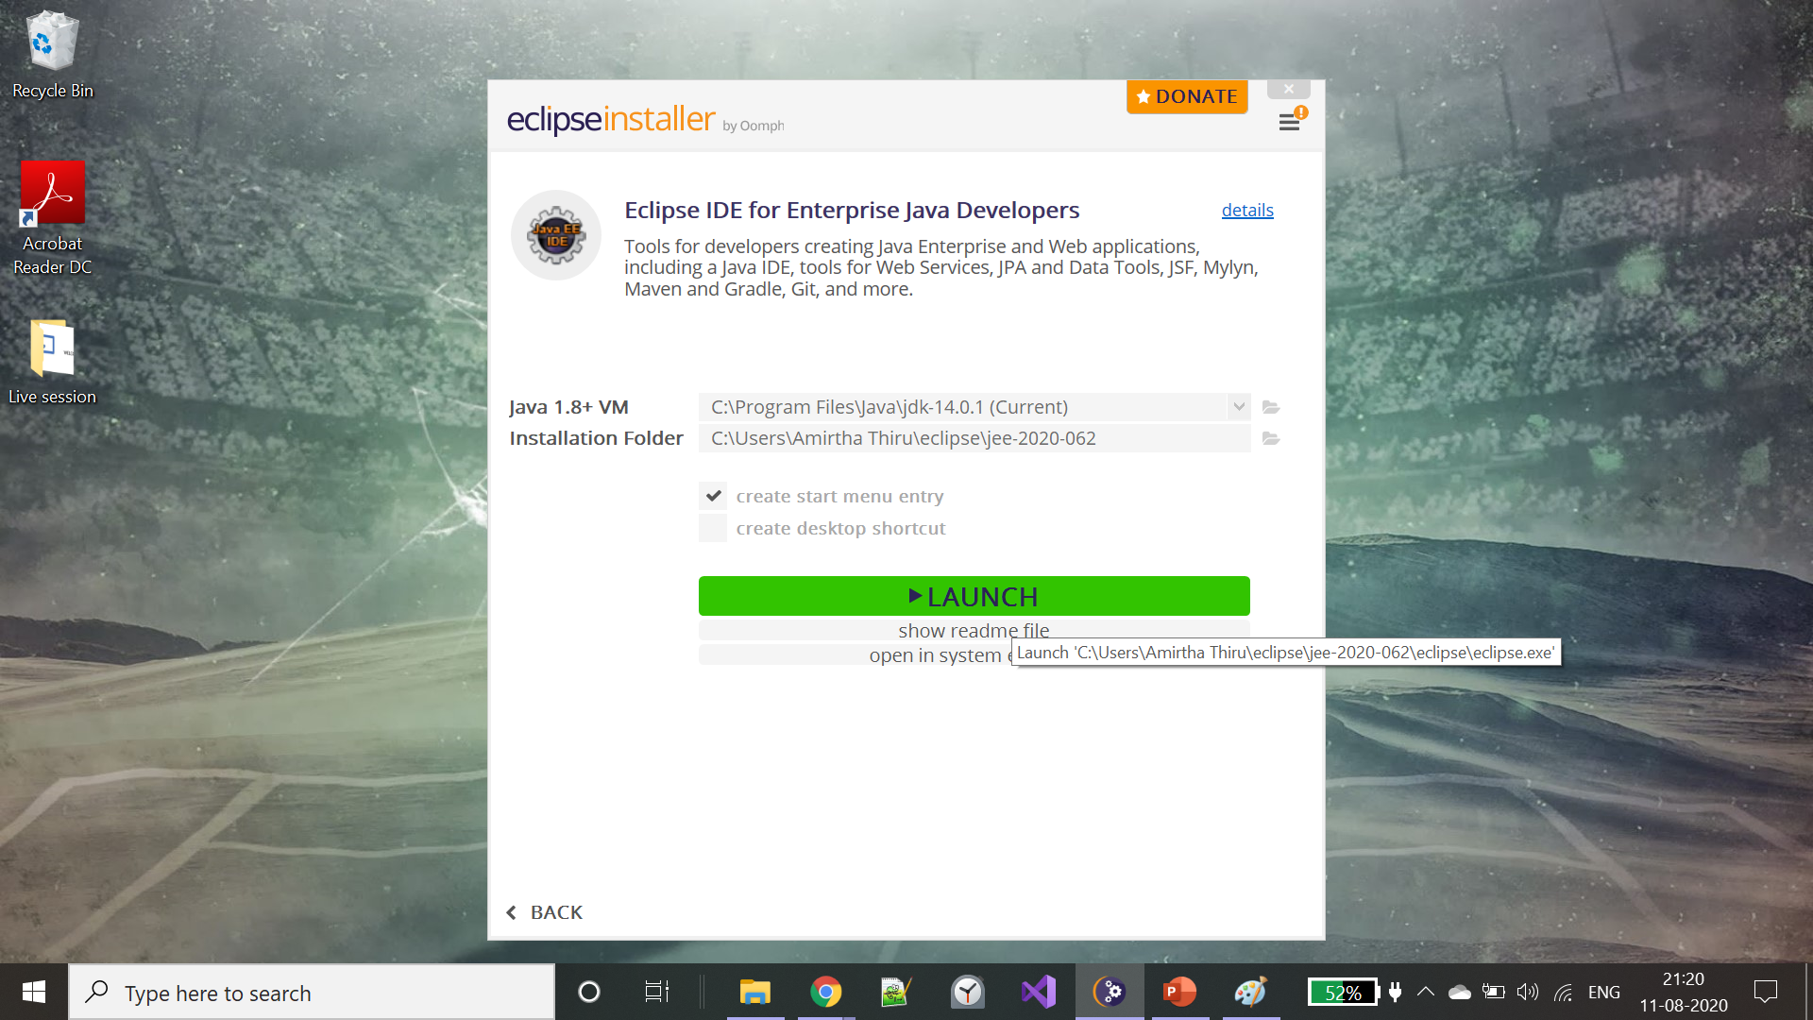
Click on launch – Please verify the jdk

Slide 7
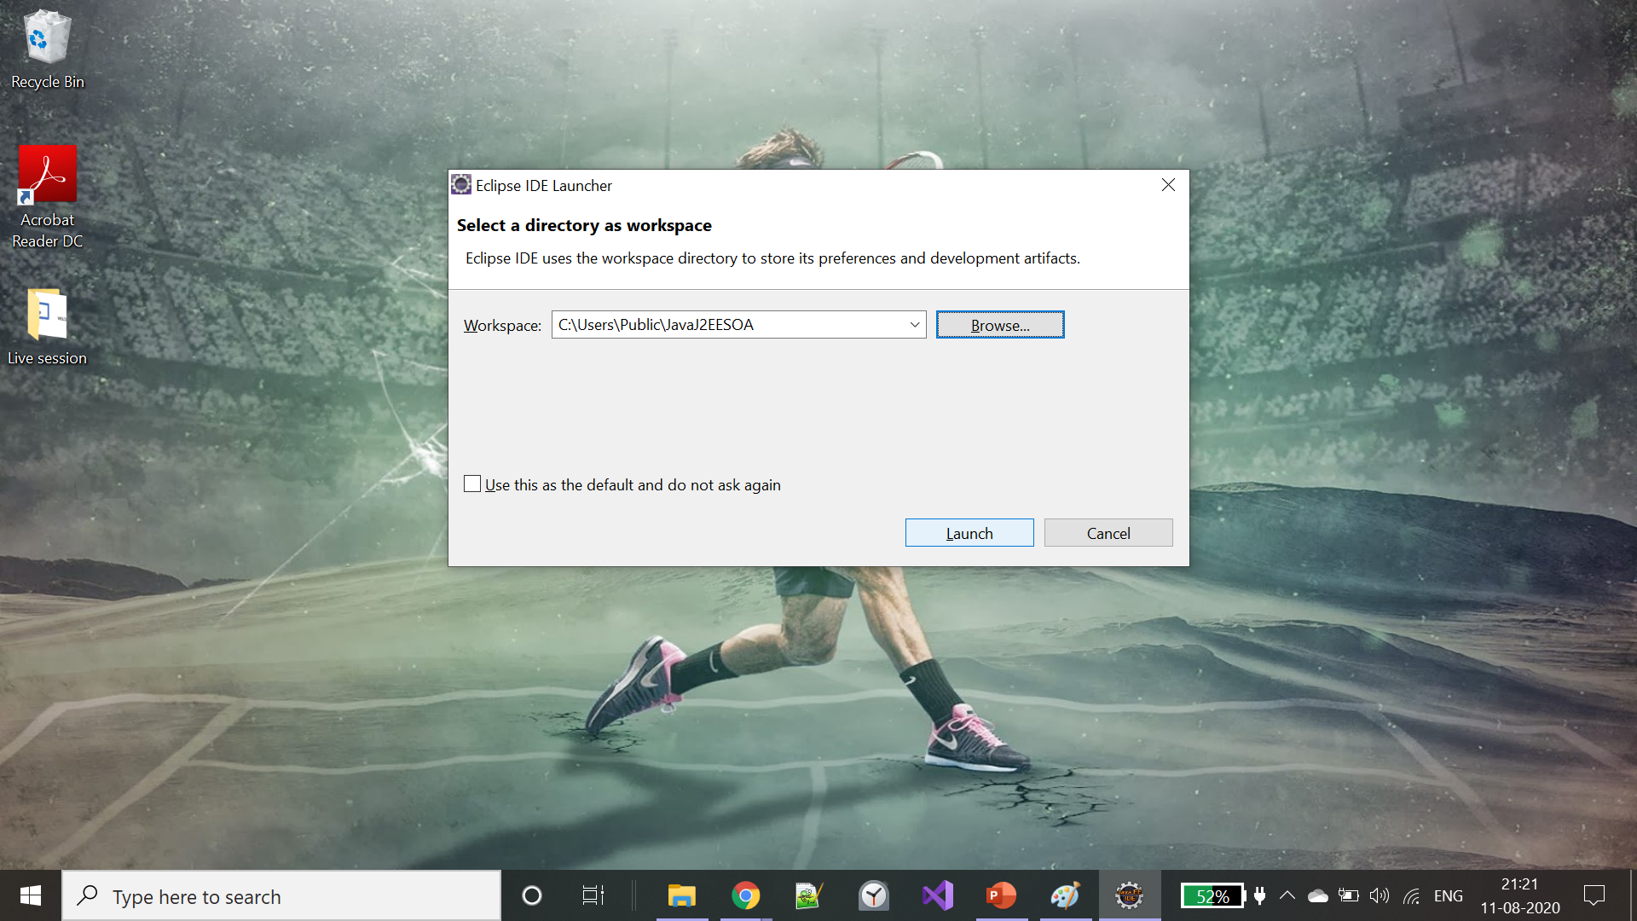
Browse the workspace directory and click ok.

